Slide 1


Slide 2


2 / 12
Foundational Concepts - II
By : Mr Shivam Supekar

Slide 3

Agenda
1
OOP in C#-Classes & Objects
2
Inheritance
3
Abstraction and Interfaces
4
Polymorphism
5
Encapsulation
6
SOLID properties
7
Use Cases
8
Assignment
9
Debrief

Slide 4
OOPS
What is Object-Oriented Programming (OOP)?
Object-Oriented Programming (OOP) is a way of designing programs where real-world things (objects) are represented in code.
Why Do We Need OOP?
Before OOP, programs were often long, repetitive, ha rd to maintain.
OOP solves this by letting us break down complex things into small, understandable pieces (called objects).

Slide 5
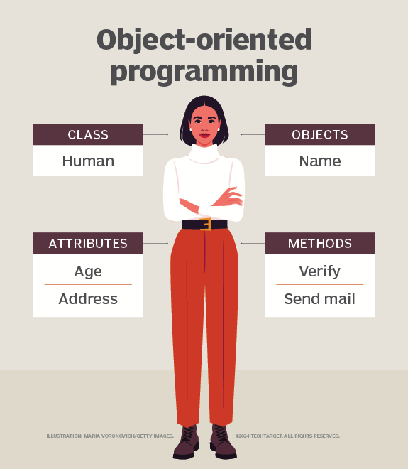

Slide 6
Classes
Understanding Classes
A class in C# is a template or blueprint used to create objects. It defines what kind of data an object will hold and what actions or behavior it will perform.
We need classes to model real-world entities in code by grouping related data and behaviors together, allowing for organized, reusable, and scalable programming.
Structure of a Class
A class usually contains:
Fields or Properties → Represent the data of the object.
Methods → Actions or behaviors the object can perform.
Constructors → Special methods to help create objects (we’ll cover this separately).

Slide 7
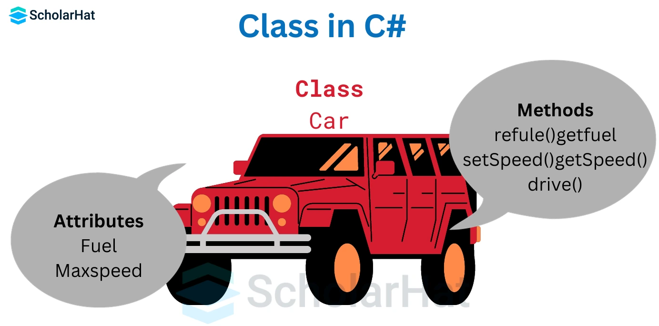

Slide 8
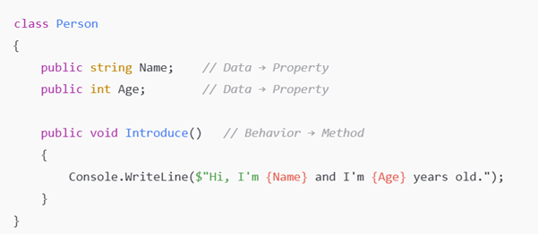
Example of a Class in C#

Slide 9
Objects
An object is something you create from a class that you can actually use—it holds real data and can-do things based on what the class describes.
Why Do We Need Objects?
We need objects because they bring classes to life, letting us create multiple usable versions with their own data.
Example, from one Car class, we can create different cars like "BMW" and a "Toyota" from the same Car class, each with its own color, engine, and features.

Slide 10
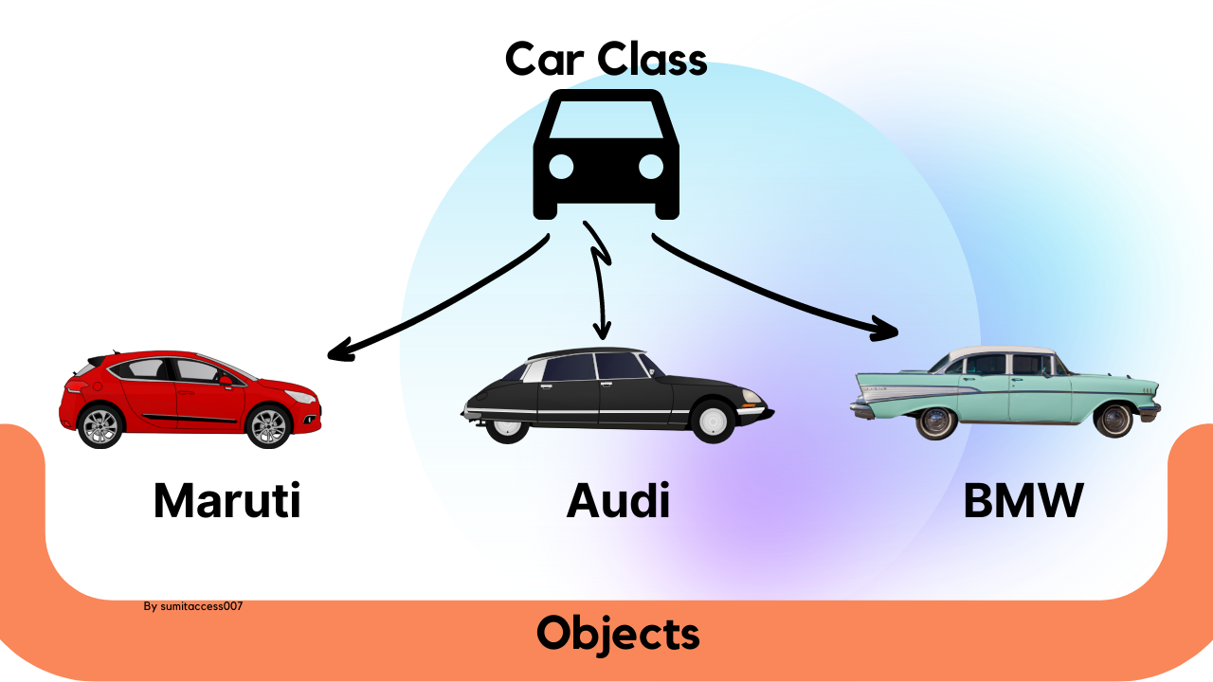
Objects

Slide 11

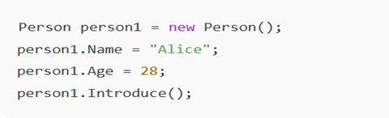
Objects
Memory Perspective
A class doesn’t take up memory on its own—memory is only used when you make an object from it.
Syntax of Object Creation in C#
Creating Objects from the Class:

Slide 12
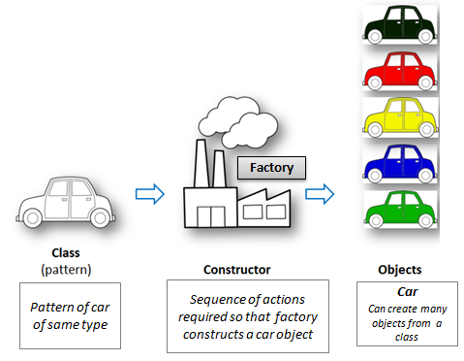

Slide 13

Inheritance
What Is Inheritance? Inheritance lets one class use code from another. It's like passing down traits from a parent to a child.
Why Use It?
Reuse code instead of rewriting it
Make better organized and cleaner programs
Create specific types from general ones
Key Terms:
Base Class: The original class (parent)
Derived Class: The class that inherits (child)
Symbol ‘:’ :Used to show inheritance in C#

Slide 14
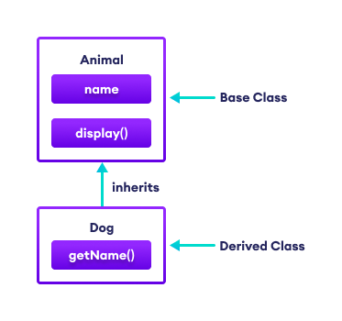
Inheritance

Slide 15
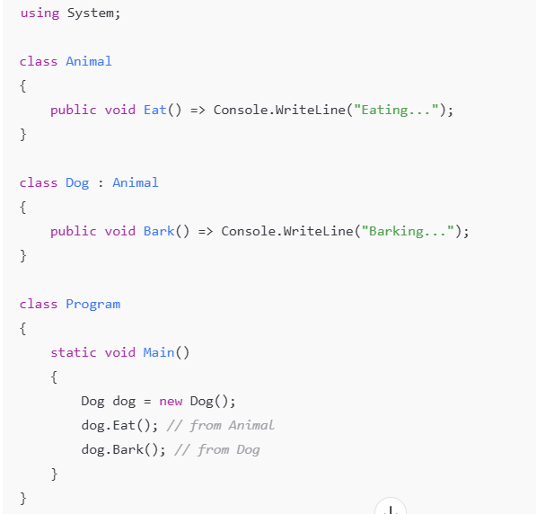
Inheritance Example in C#

Slide 16
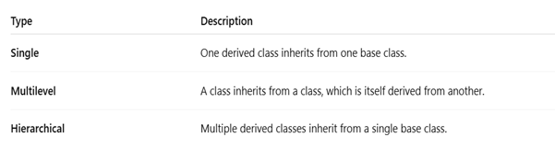
Types of Inheritance Supported in C#

Slide 17
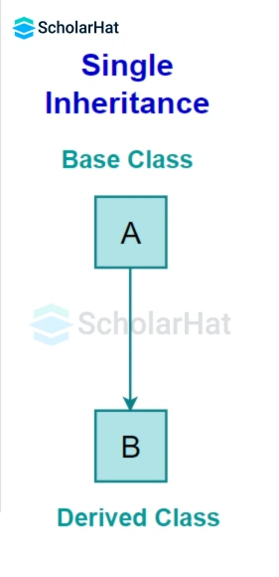
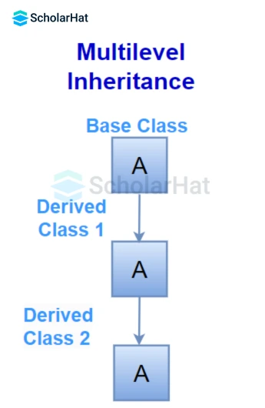
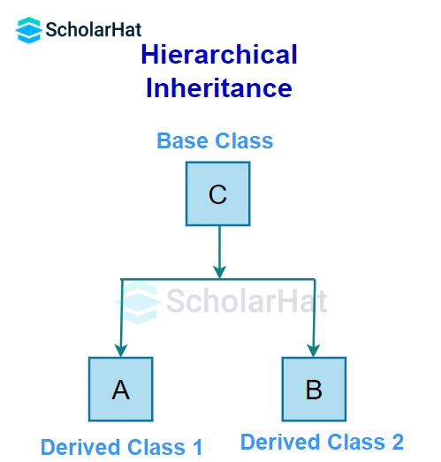
Types of Inheritance Supported in C#

Slide 18
Abstraction
What is Abstraction?
Hides internal details and shows only essential features
Answers “What to do?”, not “How to do it?”
Why Use Abstraction?
Reduces complexity by focusing on important parts
Provides security by hiding sensitive logic
Makes interaction easier without knowing internal details
Supports clean, modular, and extendable code
Advantages:
Simplifies Code – Only shows what matters
Reduces Complexity – Work without knowing the inside
Increases Security – Hides sensitive data
Improves Modularity – Easy to maintain and extend

Slide 19
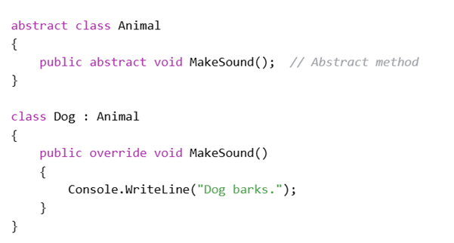
Abstraction

Slide 20
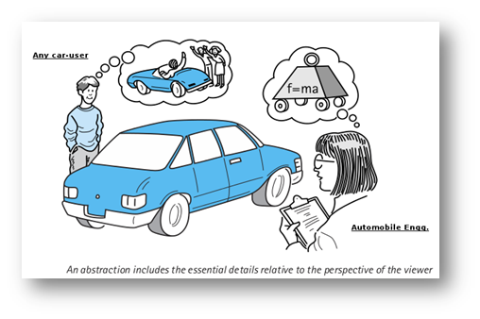

Slide 21
Interfaces
What is Abstraction?
Hides internal details and shows only essential features
Answers “What to do?”, not “How to do it?”
Why Use Abstraction?
Reduces complexity by focusing on important parts
Provides security by hiding sensitive logic
Makes interaction easier without knowing internal details
Supports clean, modular, and extendable code
Advantages:
Simplifies Code – Only shows what matters
Reduces Complexity – Work without knowing the inside
Increases Security – Hides sensitive data
Improves Modularity – Easy to maintain and extend

Slide 22
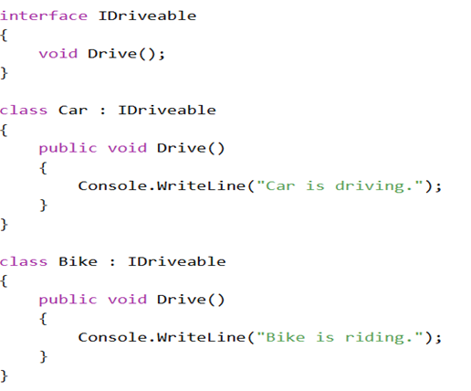
Interface

Slide 23
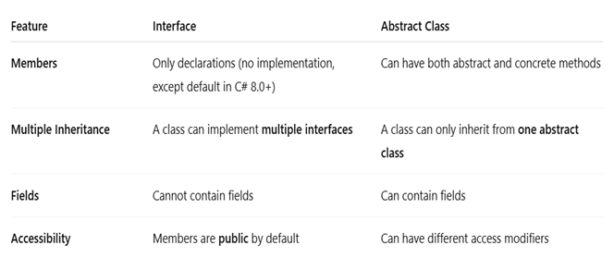
Difference between Interface And Abstraction

Slide 24
Polymorphism
What Is Polymorphism? Polymorphism means “many forms.” In C#, it lets the same method name do different things based on the context (like different parameters or class types).
Why Use It?
Write flexible code that works with different object types
Add new features without changing old code
Keep method names consistent across classes
Enable behavior that can change at runtime
Key Terms:
Base Class: The original class (parent)
Derived Class: The class that inherits (child)
Symbol ‘:’ :Used to show inheritance in C#

Slide 25
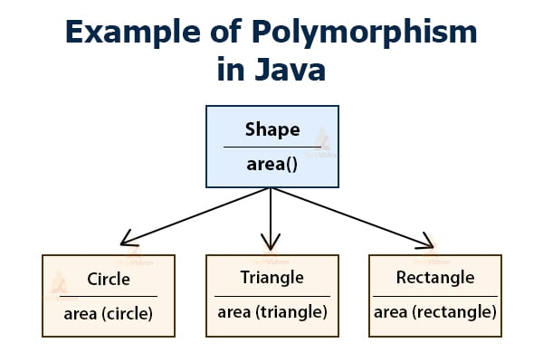

Slide 26
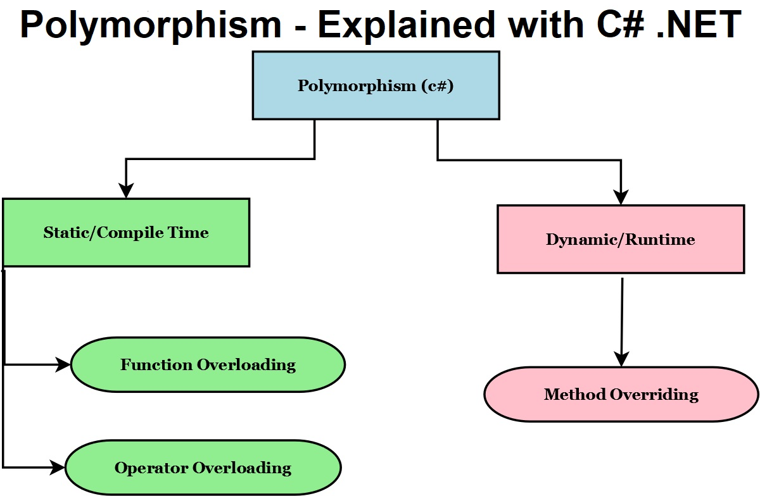

Slide 27
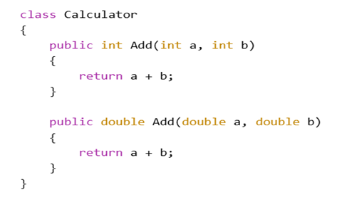
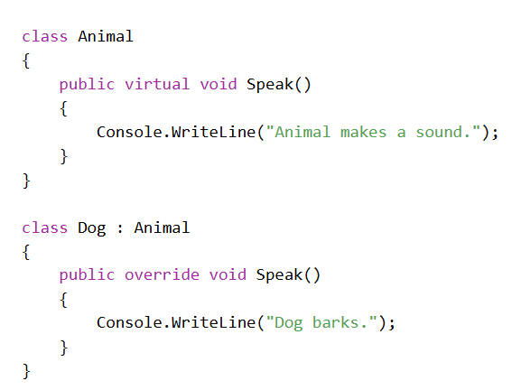
Types of Polymorphism In C#
Compile-Time Polymorphism (Method Overloading)
Run-Time Polymorphism (Method Overriding)

Slide 28
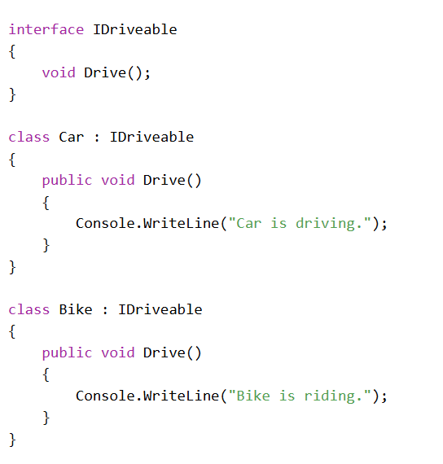
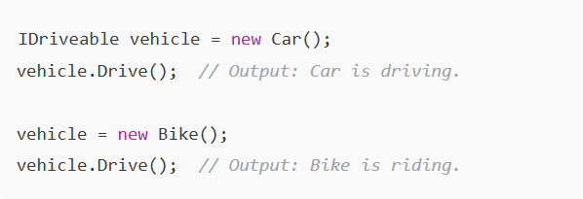
Polymorphism In Interfaces
Polymorphism can also be implemented using interfaces. Multiple classes implementing the same interface can provide different implementations of the interface’s methods.
Usage:

Slide 29
Encapsulation
What is Encapsulation?
Encapsulation means bundling data and methods that operate on that data into a single unit (class)
It also involves restricting direct access to some of an object’s components
Why Use It?
Protects data from unintended changes
Improves security and control
Hides internal implementation from outside code
Makes code easier to maintain and debug
How its done in C#:
Use access modifiers (private, public, protected)
Access data through getters and setters (properties)

Slide 30
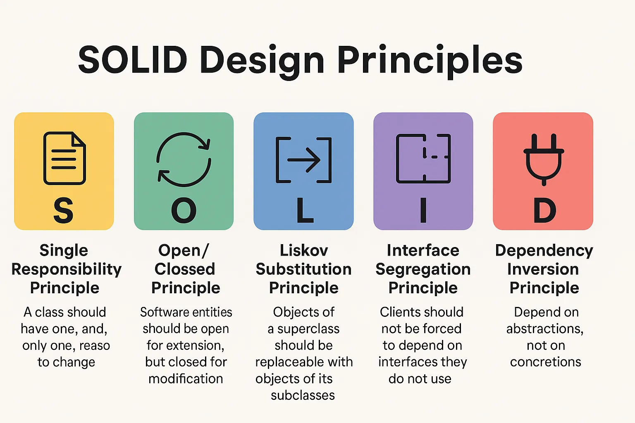
SOLID Properties

Slide 31
Use Cases
Concept | Use Case Example
Classes & Objects | Model real-world entities like Product, User, Order in e-commerce or ERP apps
Inheritance | Create reusable hierarchies (e.g., Employee → Manager, Vehicle → Car)
Polymorphism | Implement multiple payment types under one interface (CreditCard, PayPal)
Interfaces | Define contracts for services like ILogger, INotification, IDataAccess
S - Single Responsibility | Separate concerns: UserService, EmailService, InvoiceService
O - Open/Closed | Add new behaviors (e.g., shipping types) without modifying existing classes
L - Liskov Substitution | Use derived classes (PayPal, CardPayment) wherever base class PaymentMethod is used
I - Interface Segregation | Split large interfaces (IWorker) into smaller ones (IWorkable, IEatable)
D - Dependency Inversion | Inject abstractions (e.g., ILogger) into classes using .NET Core DI container

Slide 32

Assignment
1.) Classes & Objects –Student Management System
Objective :
Create and use classes with properties, constructors, and methods.
🔧 Tasks:
Create a class Student with the following:
Properties: Name, RollNumber, Course, Marks (out of 100)
Method: DisplayDetails() to print student details
In Main():
Create at least 3 objects of Student
Use a constructor to assign values
Call the DisplayDetails() method for each student

Slide 33
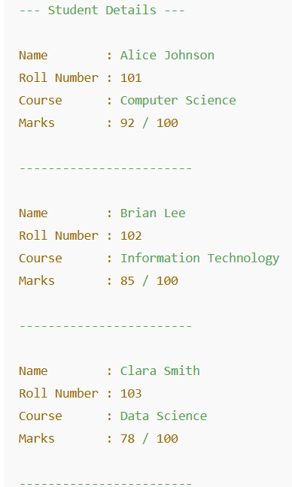
Assignment
Output Format:

Slide 34
Assignment
2.) Inheritance – Employee Hierarchy
Objective :
Apply inheritance and constructor chaining in C#.
🔧 Tasks:
Create a base class Employee:
Properties: EmpID, Name, BasicSalary
Method: Display()
Create two subclasses:
Manager → additional property: Bonus
Developer → additional property: ProjectName
Override Display() in both subclasses.
In Main():
Create objects of Manager and Developer and display full info.

Slide 35
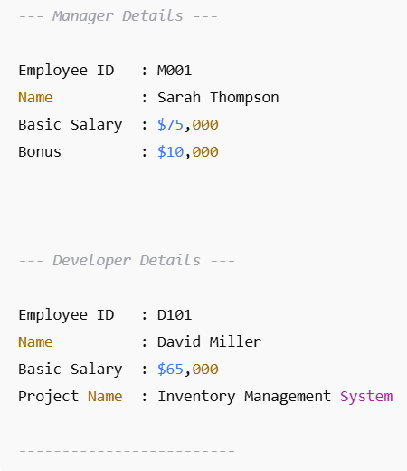
Assignment
Output Format:

Slide 36
Assignment
3.) Polymorphism – Shape Calculator
Objective :
Demonstrate method overriding and runtime polymorphism.
🔧 Tasks:
Create an abstract class Shape with:
Method: CalculateArea() (abstract)
Create subclasses:
Circle → property: Radius
Rectangle → properties: Length, Breadth
Override CalculateArea() in both.
In Main():
Use a Shape reference to call the method for each derived class (polymorphism).
Output area values with shape name

Slide 37
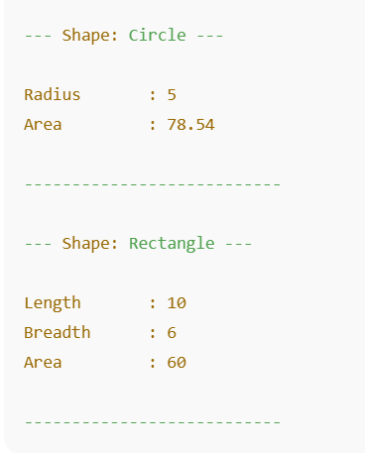
Assignment
Output Format:

Slide 38
Assignment
4.) Interfaces – Payment Gateway System
Objective :
Use interfaces to enforce common functionality across unrelated classes.
🔧 Tasks:
Create an interface IPayment with:
Methods: Pay(), Refund()
Implement it in 2 classes:
CreditCardPayment
UPIPayment
Each class should:
Store relevant details (e.g., card number, UPI ID)
Implement the methods with sample output
In Main():
Create a list of IPayment objects and call Pay()/Refund() using a loop

Slide 39
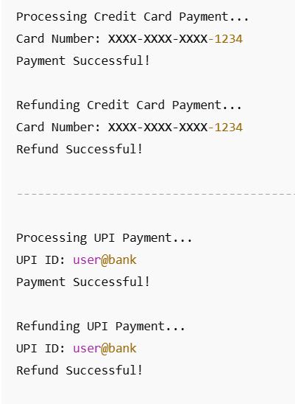
Assignment
Output Format:

Slide 40

+
+
+
+
LEVEL
Stretch Goals
+
UP
+
+
OOP Integration Project – Library System
Objective:
Combine all OOP concepts in a real-world example.
Tasks:
Create:
Base class LibraryItem with Title, ID, IsAvailable
Subclasses: Book, Magazine
Use an interface IBorrowable with methods: Borrow(), ReturnItem()
Implement the interface in Book only.
Use polymorphism to loop through all items and perform borrow/return actions based on type

Slide 41
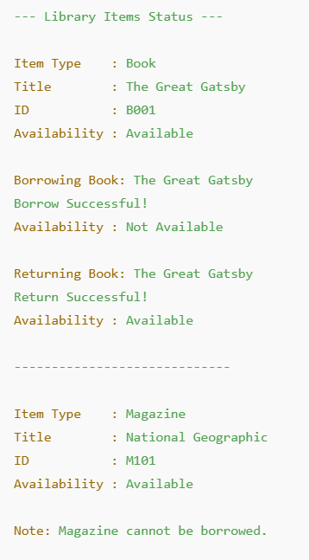
Assignment
Output Format:

Slide 42
Debrief
OOP in C#-Classes & Objects
Inheritance,polymorphism
Abstraction and Interfaces
Encapsulation, SOLID properties
Use cases

Slide 43
📘 Official Resources (High-Quality & Up-to-Date)
References
https://learn.microsoft.com/en-us/dotnet/csharp/fundamentals/object-oriented/
https://www.youtube.com/watch?v=GhQdlIFylQ8

Slide 44
Q&A

